Slide 1
Planning for Extreme Heat
How to Use CIRCA's Climate Change Vulnerability Index
01
CCVI and Methods
02
Data in Heat CCVI
03
Demo
04
Applications of Heat CCVI in Planning
05
Legal and Policy Tools
06
Zoning tools to reduce urban heat

Slide 2
Uses for the CCVI
Four General Categories are Emerging
Resilient Connecticut Phase II: CIRCA is using the CCVI during a planning process to identify project areas, which we call “Phase III” projects
Resilient Connecticut Phase III: CIRCA’s consultants are using the CCVI within the Phase III projects
Non-Resilient Connecticut CIRCA projects: CIRCA is using the CCVI for other kinds of planning efforts
Planning and concept design projects completed by others
Notes:
Rob

Slide 3
Uses for the CCVI
Four General Categories are Emerging
Resilient Connecticut Phase II: CIRCA is using the CCVI during a planning process to identify project areas, which we call “Phase III” projects
Resilient Connecticut Phase III: CIRCA’s consultants are using the CCVI within the Phase III projects
Non-Resilient Connecticut CIRCA projects: CIRCA is using the CCVI for other kinds of planning efforts
Planning and concept design projects completed by others
Notes:
Rob

Slide 4
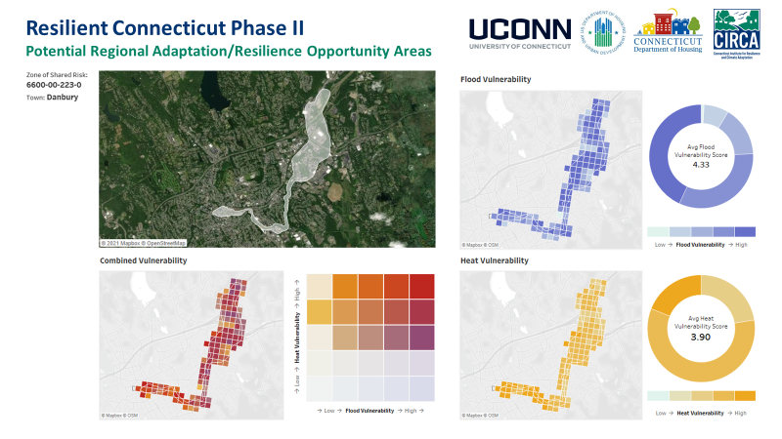
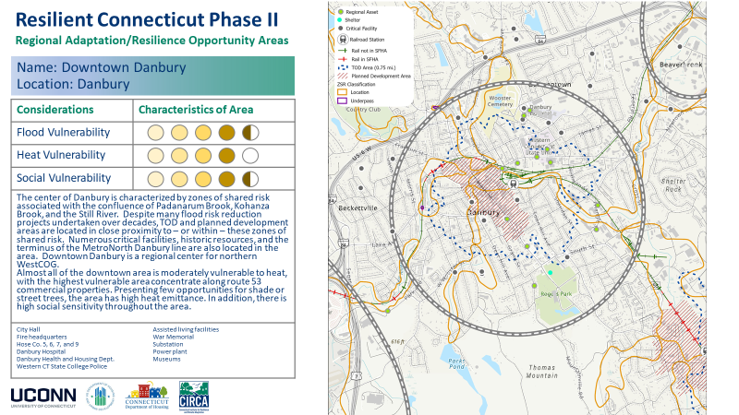
Notes:
Rob

Slide 5
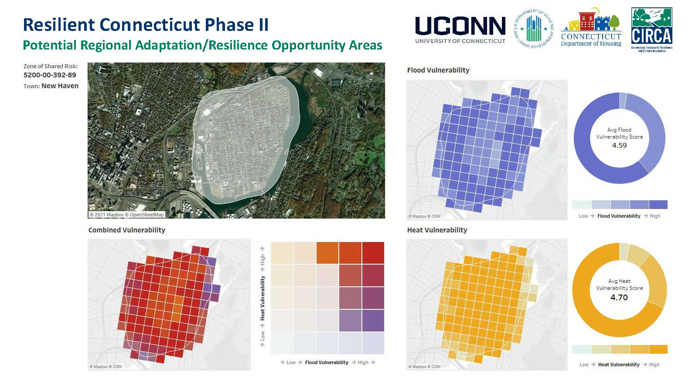
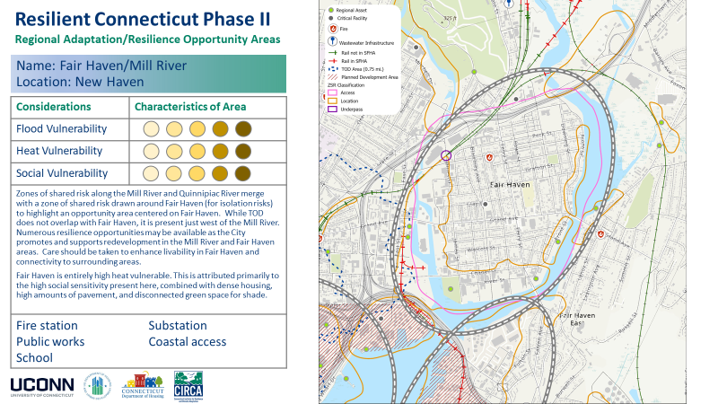
Notes:
Rob

Slide 6
Uses for the CCVI
Four General Categories are Emerging
Resilient Connecticut Phase II: CIRCA is using the CCVI during a planning process to identify project areas, which we call “Phase III” projects
Resilient Connecticut Phase III: CIRCA’s consultants are using the CCVI within the Phase III projects
Non-Resilient Connecticut CIRCA projects: CIRCA is using the CCVI for other kinds of planning efforts
Planning and concept design projects completed by others
Notes:
Rob

Slide 7
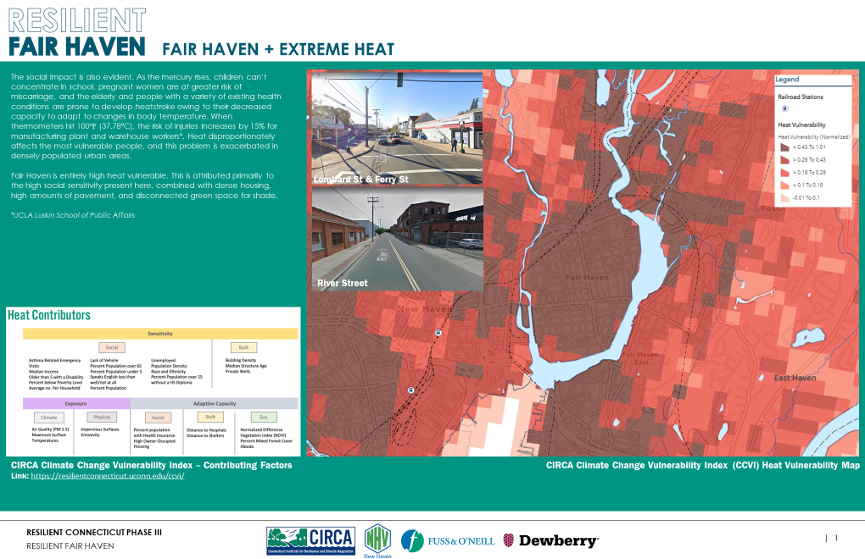
New Haven
Notes:
Rob

Slide 8
Norwalk
Notes:
Rob

Slide 9
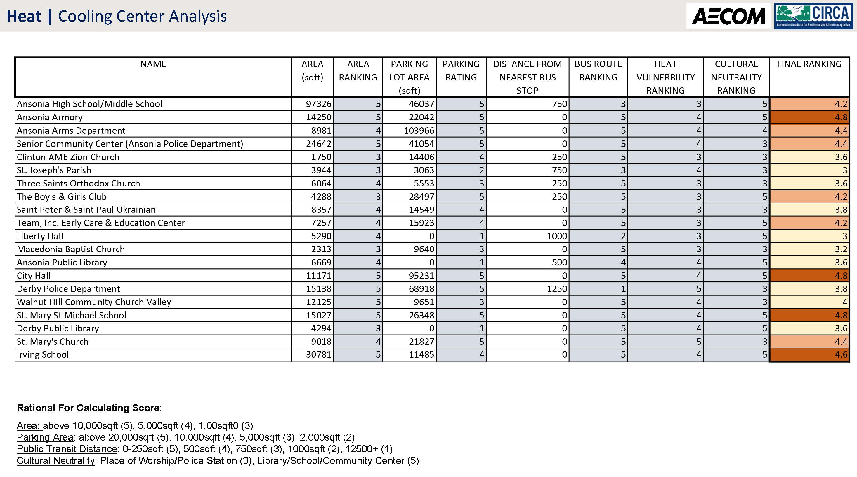
Ansonia
Notes:
Rob

Slide 10
Uses for the CCVI
Four General Categories are Emerging
Resilient Connecticut Phase II: CIRCA is using the CCVI during a planning process to identify project areas, which we call “Phase III” projects
Resilient Connecticut Phase III: CIRCA’s consultants are using the CCVI within the Phase III projects
Non-Resilient Connecticut CIRCA projects: CIRCA is using the CCVI for other kinds of planning efforts
Planning and concept design projects completed by others
Notes:
Rob

Slide 11
Notes:
Rob

Slide 12
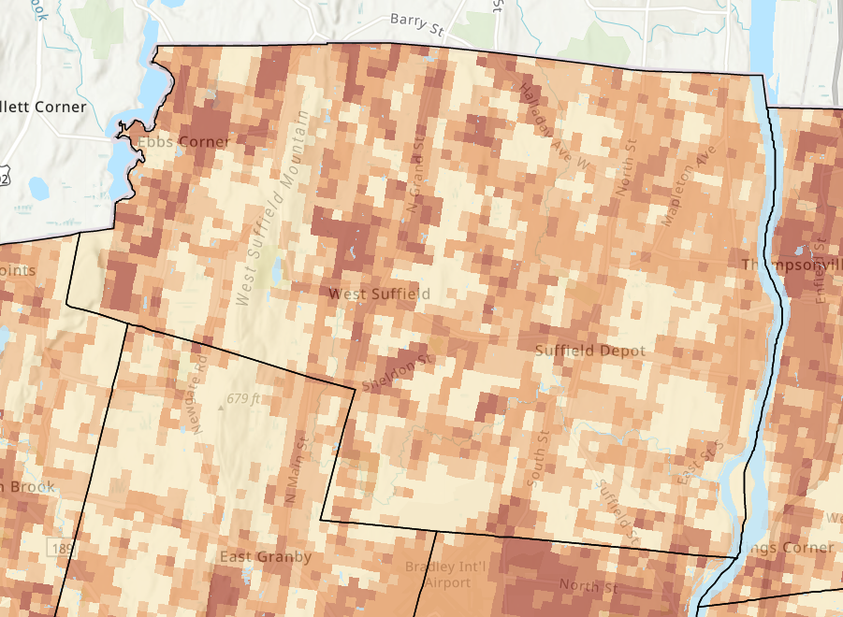
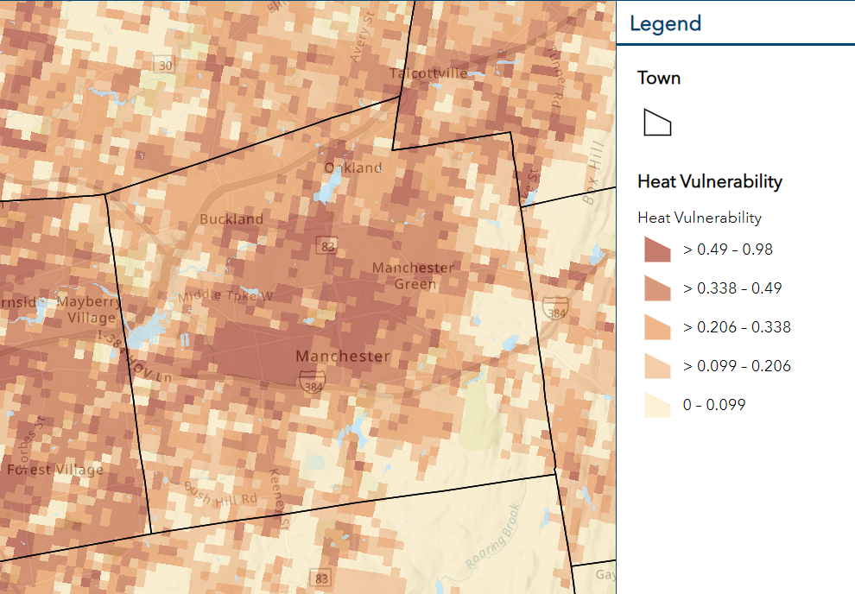
Wholesale nurseries, tobacco, and agricultural land
Development and impervious surfaces
Notes:
Rob

Slide 13
Uses for the CCVI
Four General Categories are Emerging
Resilient Connecticut Phase II: CIRCA is using the CCVI during a planning process to identify project areas, which we call “Phase III” projects
Resilient Connecticut Phase III: CIRCA’s consultants are using the CCVI within the Phase III projects
Non-Resilient Connecticut CIRCA projects: CIRCA is using the CCVI for other kinds of planning efforts
Planning and concept design projects completed by others
Notes:
Rob

Slide 14
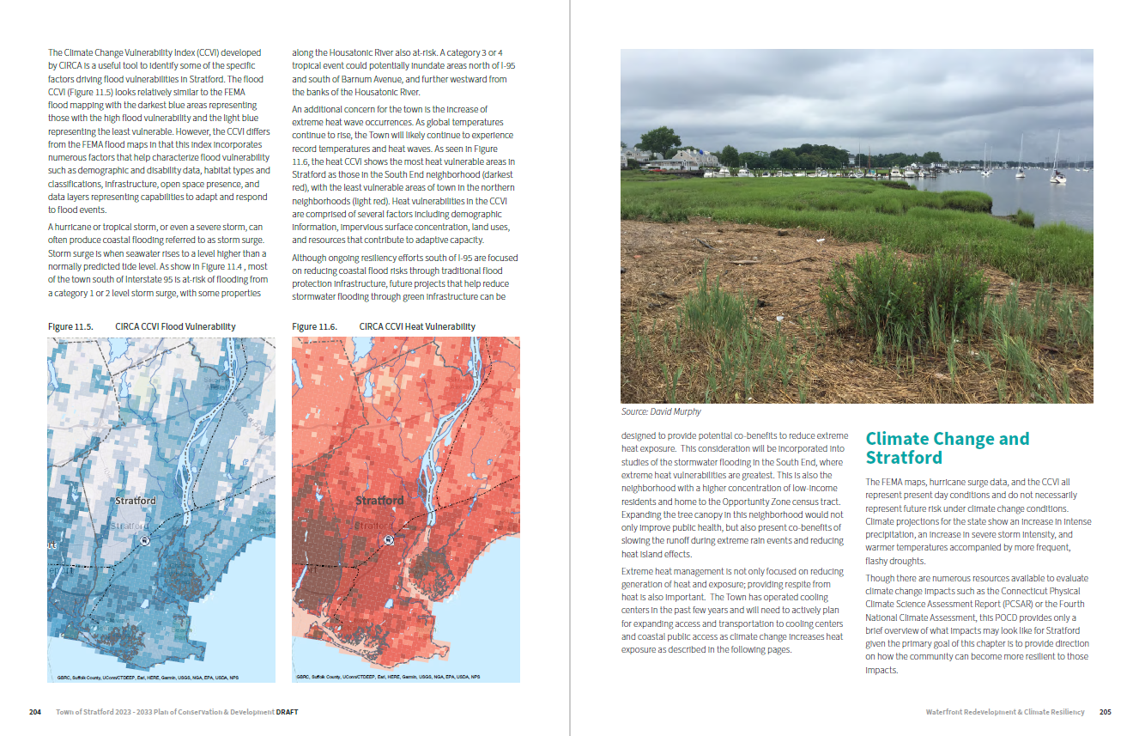
Notes:
Rob

Slide 15
Notes:
Rob

Slide 16
Notes:
Rob

Slide 17
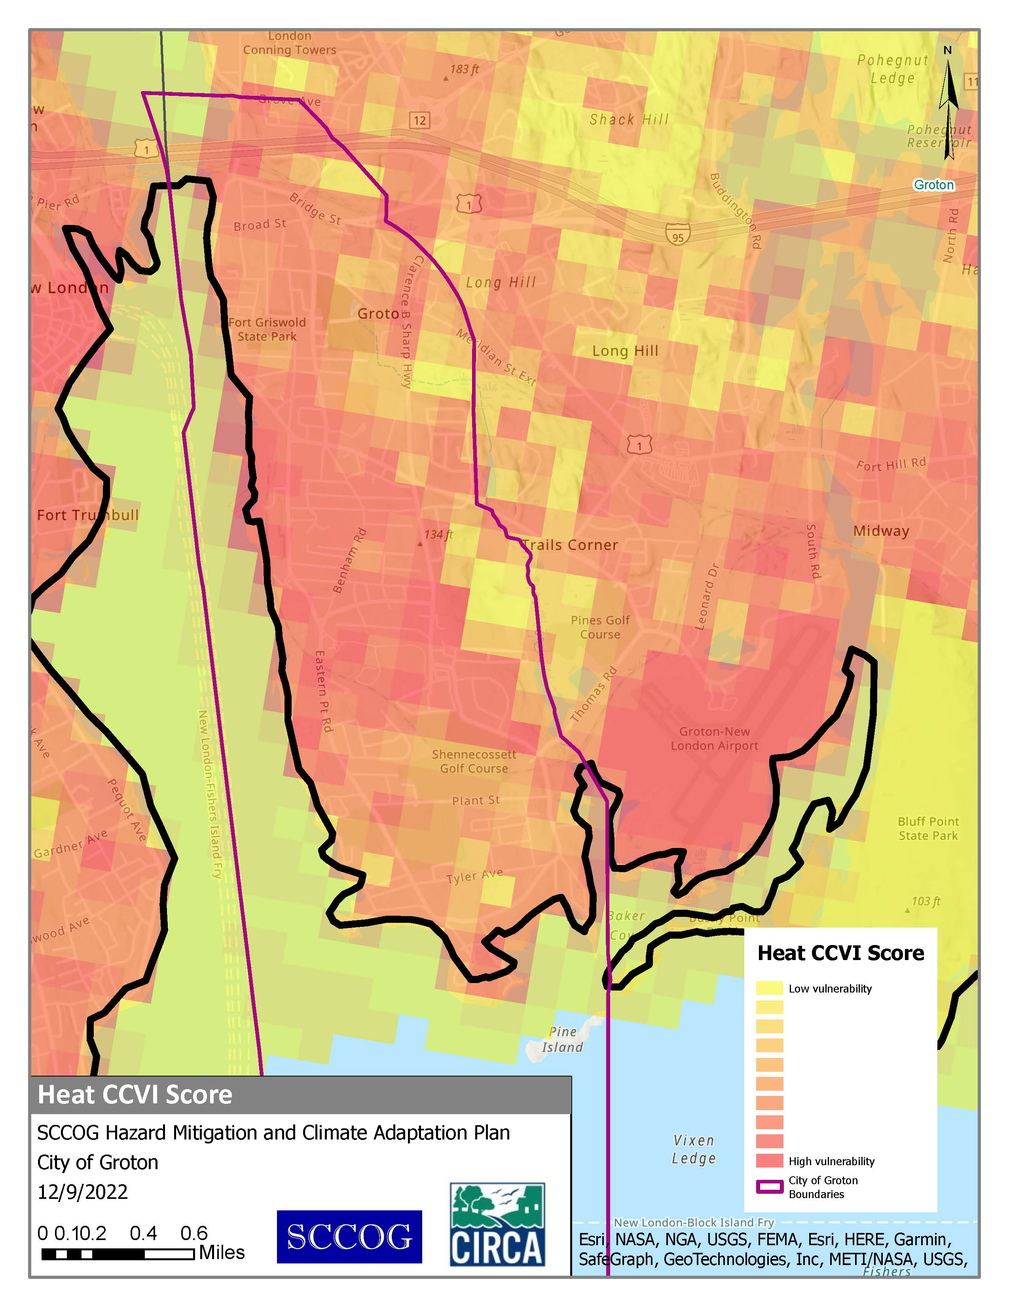
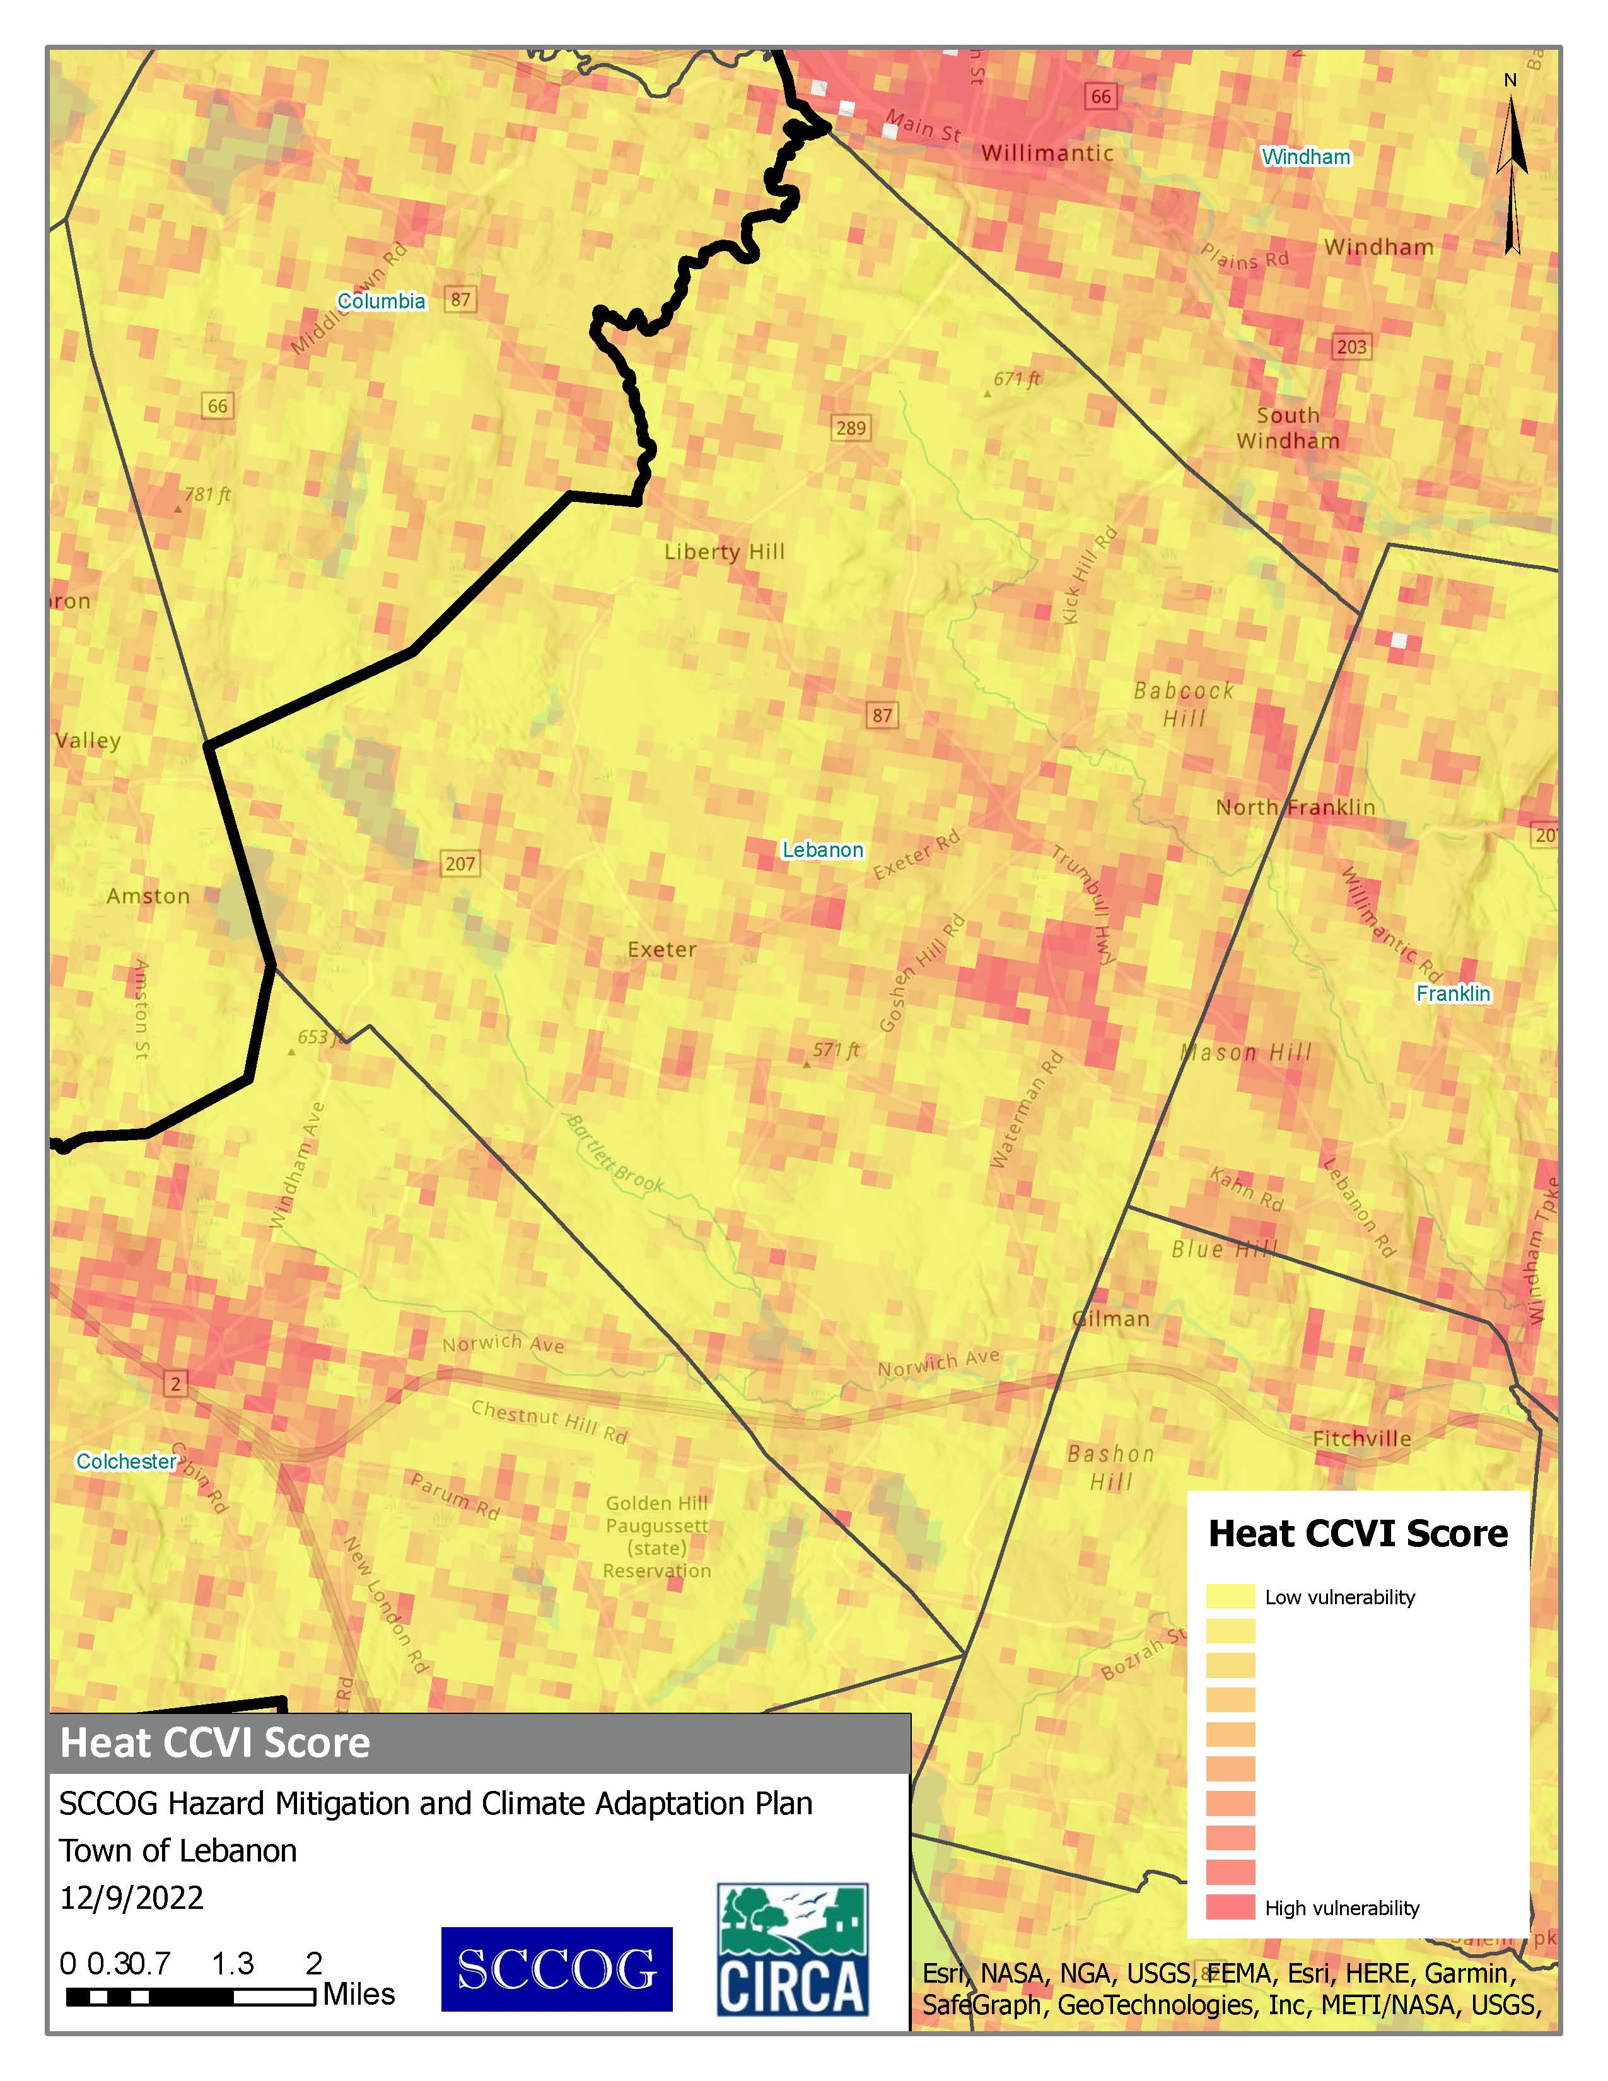
Development and impervious surfaces
Wholesale nurseries and agricultural land
Notes:
Rob

Slide 18
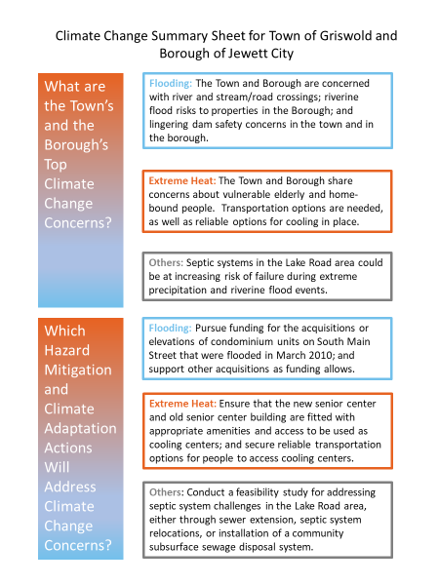
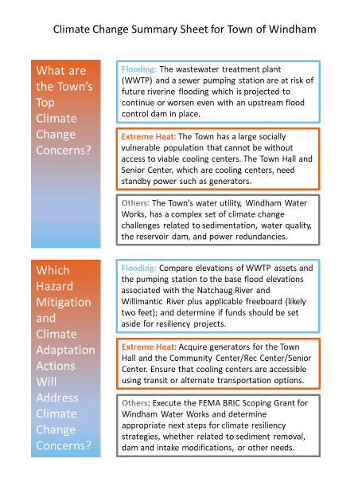
Notes:
Rob

Slide 19
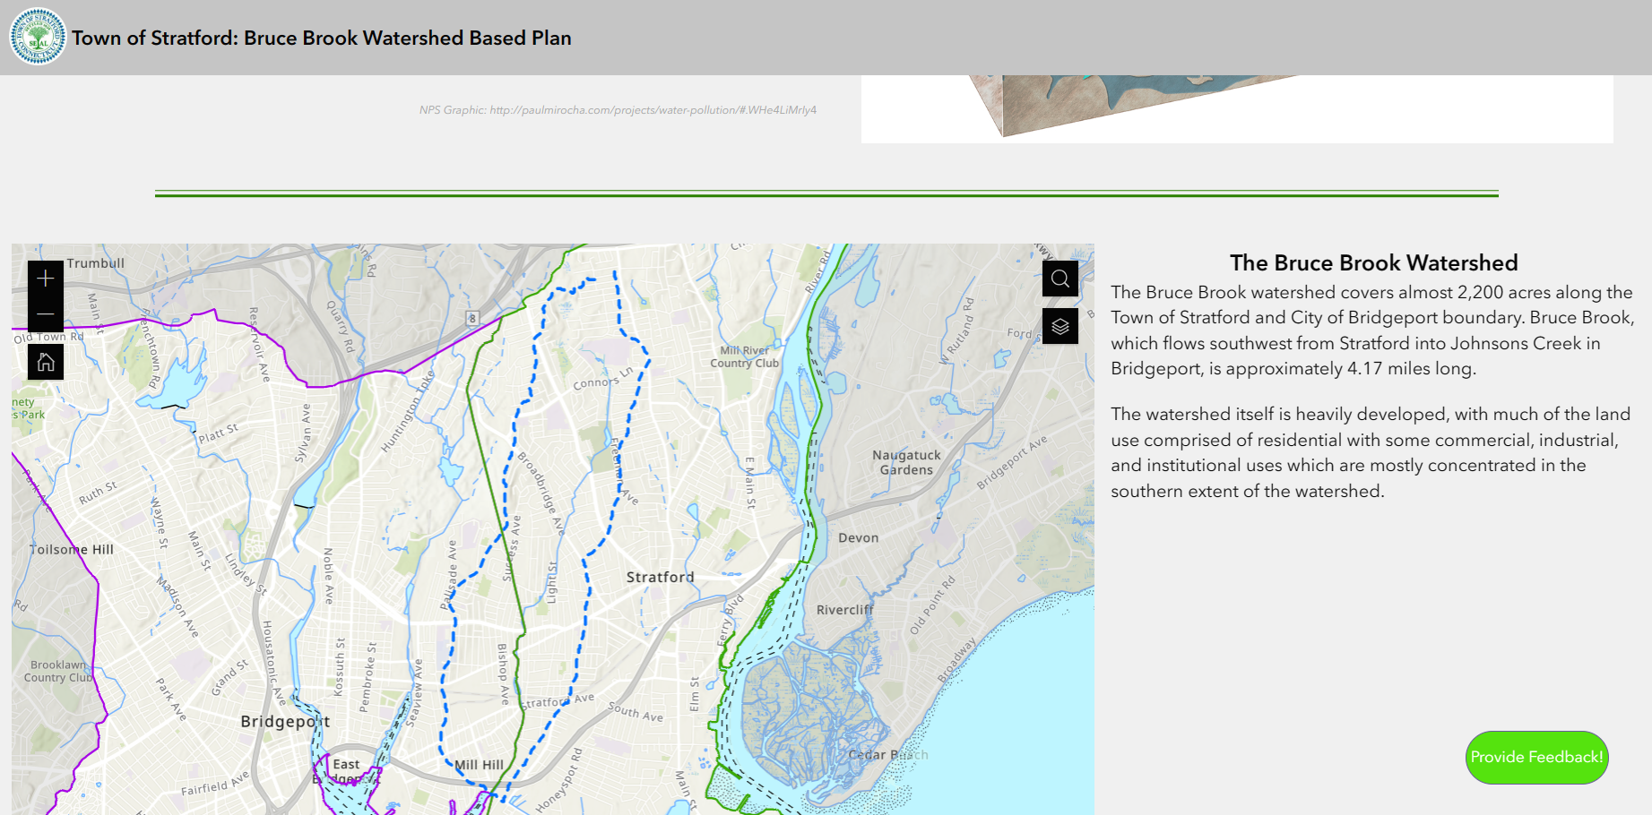
Notes:
Rob

Slide 20
Notes:
Rob

Slide 21
Planning for Extreme Heat
How to Use CIRCA's Climate Change Vulnerability Index
01
CCVI and Methods
02
Data in Heat CCVI
03
Demo
04
Applications of Heat CCVI in Planning
05
Legal and Policy Tools
06
Zoning tools to reduce urban heat

