Slide 1

Planning for Extreme Heat - How to Use CIRCA's Climate Change Vulnerability Index
Yaprak Onat, Ph.D., P.E.
Associate Director of Research
David Murphy, P.E., CFM,
Director of Resilience Engineering
Louanne Cooley,
Legal Policy Fellow

Slide 2
The content of this webinar
01
CCVI and Methods
02
Data in Heat CCVI
03
Demo
04
Applications of Heat CCVI in Planning
05
Legal and Policy Tools
06
Zoning tools to reduce urban heat

Slide 3
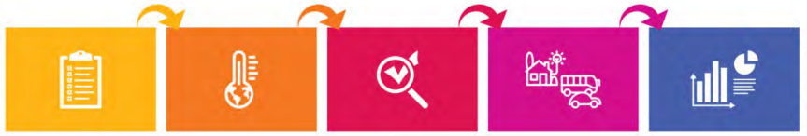
Climate Change Vulnerability Index
“Vulnerability is the degree to which a system is susceptible to, or unable to cope with, adverse effects of climate change” (IPCC 2007)
Set goals and method for the CCVI that best meet the state climate change needs
Look at the best available science and data on climate change to reflect the vulnerability
Identify and map the regions, infrastructure and other assets that will be most impacted
Score the indicators and vulnerability
Compile and share results
Slide adapted from Santa Barbara CCVA
Notes:
Climate change vulnerability is a concept that describes how strongly people or ecosystems are likely to be affected by climate change.

Slide 4
Climate Change Vulnerability Index (CCVI)
Aggregates different types of data
Visualize patterns of vulnerability
Scores relative vulnerability to the region as a whole
Allows first screening for planning and decision making
Notes:
We need frequency and consequence in terms of risk

Slide 5
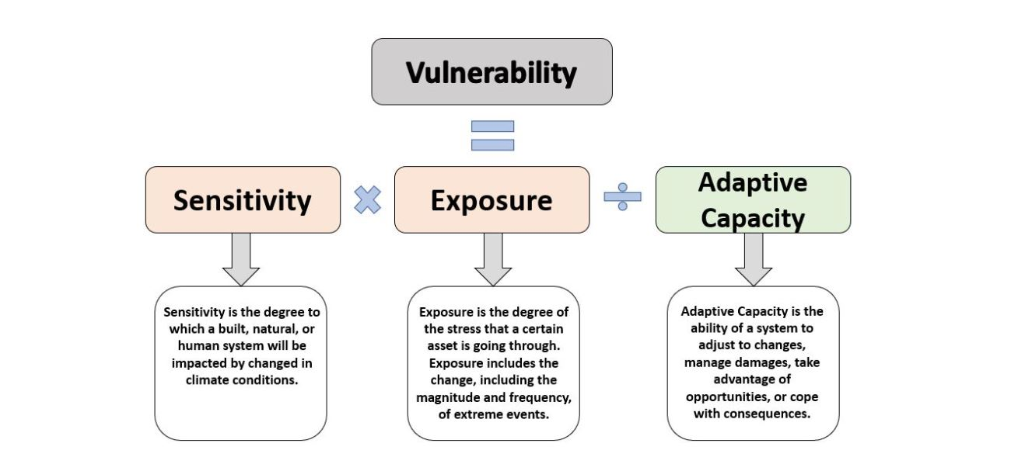
Climate Change Vulnerability Components
Notes:
Climate vulnerability depends on several factors, such as the type and magnitude of climate change impacts, the sensitivity and exposure of the system, and the adaptive capacity or resilience of the system¹.

Slide 6
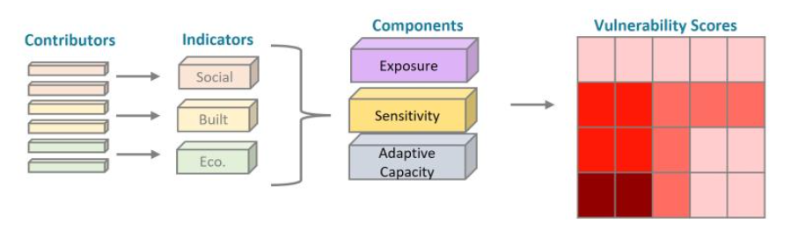
Climate Change Vulnerability Index Methodology
Decide on contributors that are statewide and high resolution
Process contributors to the 10-acre grids to obtain indicators
Categorize them into its components
Calculate vulnerability score and normalize them

Slide 7

CCVI as part of Resilient Connecticut
CVI
Started as Coastal Vulnerability Index
CCVI 1.0
Developed for New Haven and Fairfield Counties
CCVI 2.0
State-wide and includes heat and flood vulnerability
ROARs
Assist in defining Resilience Opportunity Areas

Slide 8
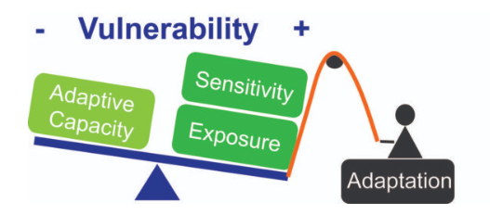
Heat Vulnerability
Map vulnerable areas to heat and identify the contributors of the changes in heat to vulnerability.
https://clarkfork.org/our-work/what-we-do/monitor-watershed-health/watershed-vulnerability-assessment/
Notes:
: Including heat vulnerability in the index provides valuable information for adaptation planning and policymaking. It helps identify areas that require investments in heat mitigation measures, such as urban planning strategies, improved building codes, early warning systems, and public health interventions. By understanding the specific vulnerabilities related to heat, decision-makers can allocate resources more effectively and develop strategies to reduce the risks associated with rising temperature

Slide 9
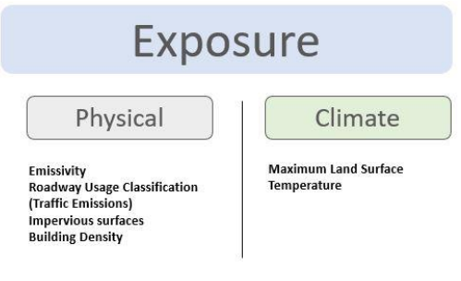
CCVI – Heat Vulnerability Data

Slide 10
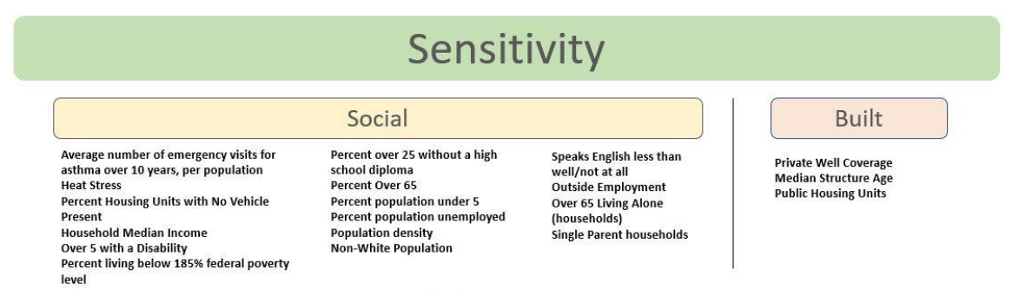
CCVI – Heat Vulnerability Data

Slide 11
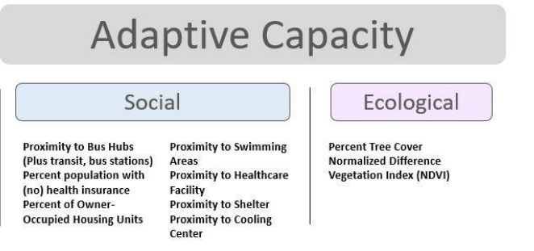
CCVI – Heat Vulnerability Data

Slide 12
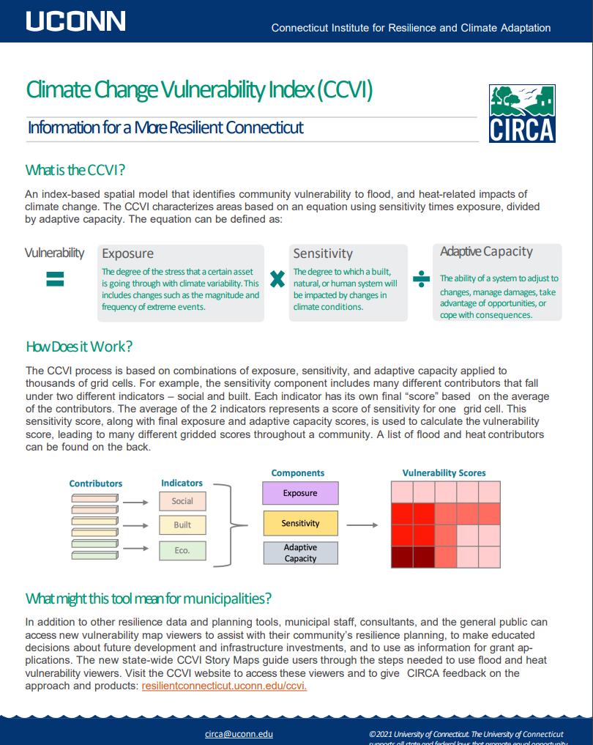
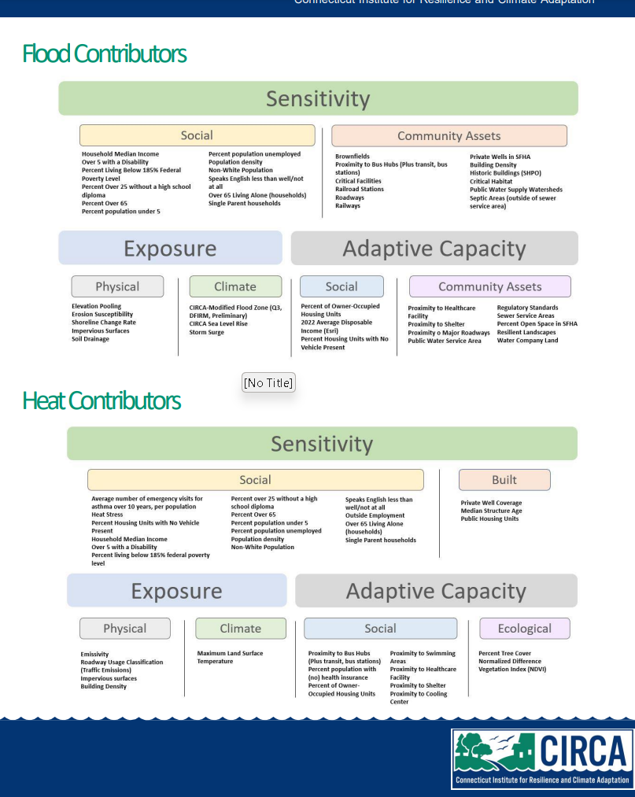
https://resilientconnecticut.uconn.edu/ccvi/
Notes:
https://resilientconnecticut.uconn.edu/ccvi/

Slide 13
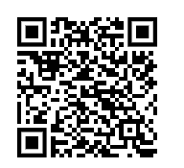
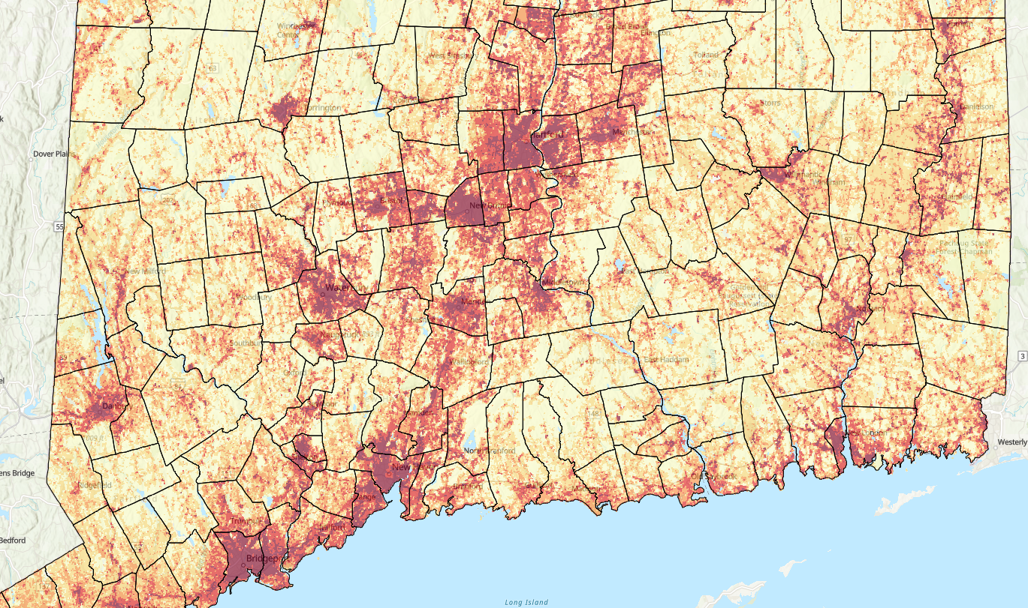
Climate Change Vulnerability Index
CIRCA Team
Yaprak Onat, David Murphy, Mary Buchanan, Nicole Govert, John Truscinski
SLR Consulting
Victoria Vetre, Meg McGaffin, Connor Dickes, Noah Slovin, Jon Philipsborn

